Slide 1
A Special Legislative Briefing on the work of the
Population Health Improvement Program
May 24, 2018

Slide 2
Refresh and Reset: a Timeline
Prevention Agenda mandate 2013
Joint CHNA – Chronic Diseases Rise to the Top – 2013 and 2016
Counties, hospitals, CBOs, health plans, schools and colleges, libraries commit to work together to improve health of residents
Data driven initiative grows into the Long Island Health Collaborative
State Health Department issues RFP eleven (11) regional Population Health Improvement Program
Nassau-Suffolk Hospital Council awarded PHIP contract for Long Island region
Current Status: Year 4 concludes January 2019
www.lihealthcollab.org
2/11

Slide 3
All Healthcare Is Local
Every community, every neighborhood is different
Local data tells a story
Drivers of chronic disease are universally the same
www.lihealthcollab.org
3/11
Notes:
Understanding that all healthcare is local – meaning every community, every neighborhood looks different and has its own unique health issues and challenges – requires an ability to look at data from a hyperlocal perspective. LIHC is able to do this via its primary collection tools – Community Health Assessment Survey – and the qualitative data collected via summits/focus groups, etc. On the flip side, all chronic disease drivers are universal – meaning that lifestyle choices – specifically food choices and access and physical activity levels – play a disproportionate role in health outcomes, chronic disease incidence.

Slide 4
Coordinating the Region’s Population Health Activities
Our multi-layered work always begins with our most valuable strategies,
Convening partners
Engaging in primary and secondary data collection and analyses
Conducting consumer and provider-facing public information/awareness campaigns
Supporting adoption of policies related to healthier living
Promoting chronic disease self-care
Providing a web-based walking initiative for use by the public and organizations seeking a platform in which to engage patients/clients/employees in a physical activity program
Emphasizing the role of social determinants of health in all policies and programs
Nutrition Behavioral Health Physical Activity
www.lihealthcollab.org
Notes:
As just mentioned, Healthy Eating/Food Access and Physical Activity are the pillars upon which the region’s population health activities rest. These components are the two that have the most bearing upon chronic disease. Abundant evidence and research exists confirming that lifestyle changes in these areas can significantly improve and/or prevent chronic diseases and ensuing complications. We also know that without sound mental health, there is no good physical health. CHNAs conducted in 2013 and 2016 reflect the community’s need for mental health/substance abuse treatment and prevention services. The need is also manifested by the opioid epidemic and rising rates of depression and anxiety. Mental Health/Substance Abuse intersects all activities. Collaborative partners, especially the hospitals, are becoming more engaged in programming that speaks to the social determinants of health. The collaborative supports these efforts and interacts with a variety of stakeholders, on behalf of hospitals, to ensure programming/interventions/activities are reasonable, rooted in evidence, and lead to meaningful outcome measures. SDH also harken back to “localness” of healthcare – as one community may sorely lack affordable housing, but another has no transportation infrastructure – yet both witness high rates of asthma.

Slide 5
Data Resources
Quantitative
Vital Statistics NYS
SPARCS
NYS Community Health Indicator Reports
American Fact Finder US Census Bureau
BRFSS from CDC
PQIs from AHRQ
Community Health Assessment Survey
Qualitative
CBO Summits
Focus Groups
CCHL Trainer/Participant Feedback
Collective Impact Think Tank
Bi-monthly meetings
www.lihealthcollab.org
5/11

Slide 6
Solutions-Oriented Mindset
Follow collective impact model
Leverage diverse partners
Foster linkages
Promote VBP concept
Eliminate redundancies
Streamline practices
www.lihealthcollab.org
6/11
Notes:
The LIHC operates from a solutions-oriented approach. That means helping organizations identify partners with whom they can collaborate to bring about the greatest change - cost efficiently and effectively. True to the collective impact model, the LIHC is the backbone organization providing LIHC participants with the data, administrative support, and networking base to get the job done. Looking further down the road, we are also mindful of the powerful presence VBP contracting has and will continue to have, as the state’s healthcare delivery system continues to transform from volume to value. Our data analysis capabilities and reports will play a key role in ensuring that organizations of every type and size have a meaningful and sustainable role in healthcare/social services delivery.

Slide 7
Highlights: Projects and Activities
Cultural Competency/Health Literacy
Topic-specific Quarterly Data Reports – Physical Activity Q1
DSRIP support - NQP and Suffolk Care Collaborative
Mental Health First Aid Trainings
Are You Ready, Feet?™ Initiative
Focus Groups/Town Halls/Community Outreach Sessions
Chronic Disease Self Management Program promotion
Long Island Library Asset Mapping
Nassau County Pedestrian/Bicycle Safety Education Program
www.lihealthcollab.org
7/11

Slide 8
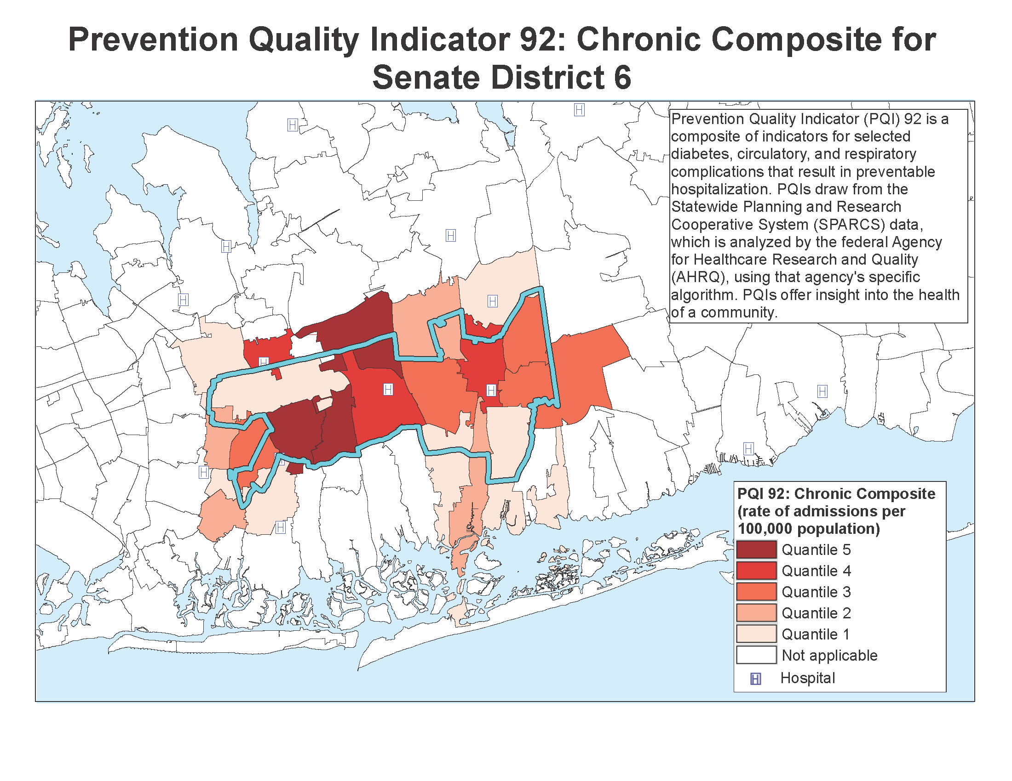
PQIs
Prevention Quality Indicators, or PQIs, are a set of measures that can be used with hospital inpatient discharge data to identify quality of care for "ambulatory care sensitive conditions."
www.lihealthcollab.org
Notes:
This map offers a glimpse of the data the LIHC is able to provide to its participants, as well as legislators. PQI - Prevention Quality Indicator analyzed by the federal agency - Agency for Healthcare Quality and Research – pulls from NY SPARCS discharge data to draw a picture of the rate of incidence of disease in a community – in this case PQI 92 is a roll-up of a handful of chronic diseases. It provides a window into the health of a community and hence your constituents. Such data informs not only programming offered by health and social service providers, but educational and outreach efforts a legislator may want to offer to his/her community. In the spirit of collaboration, such educational or awareness raising programming could be the byproduct of a local legislative office working with a nearby CBO or other health provider. Data enables you to truly understand the constituents you serve and give them what they need, which is undeniably valuable for you and them.

Slide 9
Takeaways
Funded by the PHIP, the Long Island Health Collaborative is
a data resource organizer and analyzer
the core of population health coordination
a constituent connector
All healthcare is local
www.lihealthcollab.org
10/11

Slide 10
Get in touch
631-257-6957
info@lihealthcollab.org
www.lihealthcollab.org
www.lihealthcollab.org

